Slide 1
Cluster Analysis
Lin zhang
Sse, tongji university
Dec. 2016

Slide 2
Cluster analysis
Cluster analysis groups data objects based only on the attributes in the data.
The main objective is that
The objects within a group be similar to one another and
They are different from the objects in the other groups.

Slide 3
Cluster analysis
Cluster analysis is important in the following areas:
Biology
Information retrieval
Medicine
Business

Slide 4
Cluster analysis
Cluster analysis provides an abstraction from individual data objects to the clusters in which those data objects reside.
Some clustering techniques characterize each cluster in terms of a cluster prototype.
The prototype is a data object that is representative of the other objects in the cluster.

Slide 5
Different types of clusterings
We consider the following types of clusterings
Partitional versus hierarchical
Exclusive versus fuzzy
Complete versus partial

Slide 6
Partitional versus hierarchical
A partitional clustering is a division of the set of data objects into subsets (clusters).
A hierarchical clustering is a set of nested clusters that are organized as a tree.
Each node (cluster) in the tree (except for the leaf nodes) is the union of its children (sub-clusters).
The root of the tree is the cluster containing all the objects.
Often, but not always, the leaves of the tree are singleton clusters of individual data objects.

Slide 7
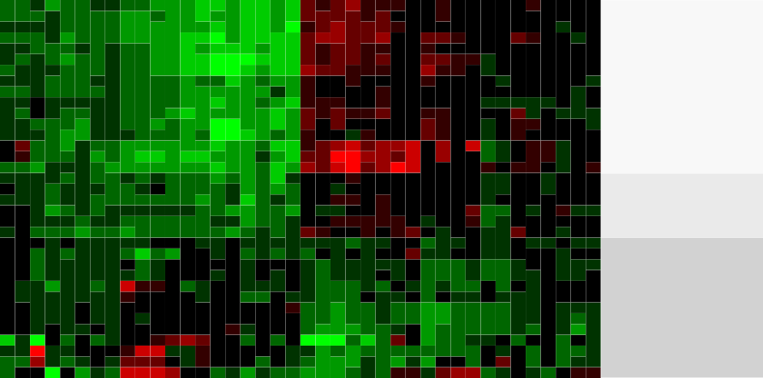
Partitional versus hierarchical
An example of hierarchical clustering
Mesothelioma Wilms tumor Colorectal adenoma Advanced HCC
Lung adenocarcinoma UBC 1
Papillary thyroid carcinoma 1 FV T−cell lymphoma
CRCC 1
Myeloma
Early stage HCC
Papillary thyroid carcinoma 1 TC Papillary thyroid carcinoma 1 CT UBC 2 low grade
UBC 2 high grade invasive Squamous cell lung carcinoma Glioblastoma
Astrocytoma Oligodendroglioma PRCC subtype 1.2A PRCC subtype 2 Breast carcinoma PRCC subtype 1 Prostate carcinoma
Endometroid ovarian cancer Serous ovarian cancer Ulcerative colitis
CRCC 2
Mucinous ovarian cancer Clear cell ovarian cancer Papillary thyroid carcinoma 2 Adrenal adenoma
Dysplastic liver Liver cirrhosis
Papillary thyroid carcinoma 3
Group 1
Group 2
Group 3
Liver development_UpL Liver development_DownE Ovary development_UpL Liver regeneration_UpL Ovary development_DownE Liver regeneration_DownE
Cerebellum development_UpL Cerebellum development_DownE Lung development_UpL
Atrial chamber development_UpL ES cell differentiation_UpL Schwann cell differentiation_UpL T cell differentiation_UpL Ventricle development_UpL
ES cell differentiation_DownE T cell differentiation_DownE
Atrial chamber development_DownE Ventricle development_DownE Lung development_DownE Schwann cell differentiation_DownE T cell differentiation_UpE
Schwann cell differentiation_UpE ES cell differentiation_UpE Lung development_UpE Ventricle development_UpE
Atrial chamber development_UpE Lung development_DownL
Atrial chamber development_DownL T cell differentiation_DownL Ventricle development_DownL Schwann cell differentiation_DownL ES cell differentiation_DownL
Liver development_DownL Liver development_UpE Liver regeneration_UpE Ovary development_UpE

Slide 8
Partitional versus hierarchical
The following figures form a hierarchical (nested) clustering with 1, 2, 4 and 6 clusters on each level.
A hierarchical clustering can be viewed as a sequence of partitional clusterings.
A partitional clustering can be obtained by taking any member of that sequence, i.e. by cutting the hierarchical tree at a certain level.

Slide 9
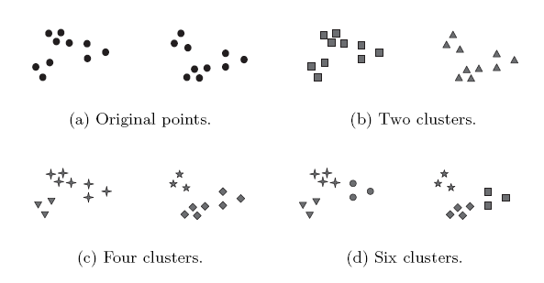
Partitional versus hierarchical

Slide 10
Exclusive versus fuzzy
In an exclusive clustering, each object is assigned to a single cluster.
However, there are many situations in which a point could reasonably be placed in more than one cluster.

Slide 11
Exclusive versus fuzzy
In a fuzzy clustering, every object belongs to every cluster with a membership weight that is between
0 (absolutely does not belong) and
1 (absolutely belongs).
This approach is useful for avoiding the arbitrariness of assigning an object to only one cluster when it is close to several.
A fuzzy clustering can be converted to an exclusive clustering by assigning each object to the cluster in which its membership value is the highest.

Slide 12
Complete versus partial
A complete clustering assigns every object to a cluster.
A partial clustering does not assign every object to a cluster.
The motivation of partial clustering is that some objects in a data set may not belong to well-defined groups.
Instead, they may represent noise or outliers.

Slide 13
K-means
K-means is a prototype-based clustering technique which creates a one-level partitioning of the data objects.
Specifically, K-means defines a prototype in terms of the centroid of a group of points.
K-means is typically applied to objects in a continuous n-dimensional space.

Slide 14
K-means
The basic K-means algorithm is summarized below
1. Select K points as initial centroids
2. Repeat
a. Form K clusters by assigning each point to its closest centroid.
b. Recompute the centroid of each cluster.
3. Until centroids do not change.

Slide 15
K-means
We first choose K initial centroids, where K is a user-defined parameter, namely, the number of clusters desired.
Each point is then assigned to the closest centroid.
Each collection of points assigned to a centroid is a cluster.
The centroid of each cluster is then updated based on the points assigned to the cluster.
We repeat the assignment and update steps until the centroids remain the same.

Slide 16
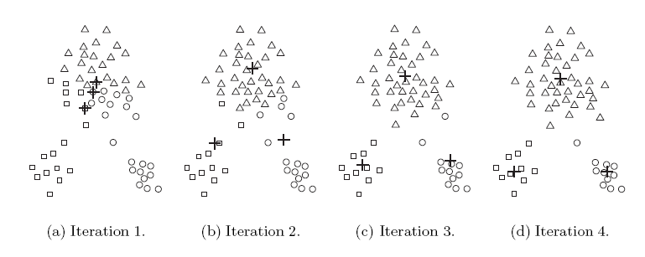
K-means
These steps are illustrated in the following figures.
Starting from three centroids, the final clusters are found in four assignment-update steps.

Slide 17
K-means
Each sub-figure shows
The centroids at the start of the iteration and
The assignment of the points to those centroids.
The centroids are indicated by the “+” symbol.
All points belonging to the same cluster have the same marker shape.

Slide 18
K-means
In the first step, points are assigned to the initial centroids, which are all in the largest group of points.
After points are assigned to a centroid, the centroid is then updated.
In the second step
Points are assigned to the updated centroids and
The centroids are updated again.

Slide 19
K-means
We can observe that two of the centroids move to the two small groups of points at the bottom of the figures.
When the K-means algorithm terminates, the centroids have identified the natural groupings of points.

Slide 20
Proximity measure
To assign a point to the closest centroid, we need a proximity measure that quantifies the notion of “closest”.
Euclidean (L₂) distance is often used for data point in Euclidean space.

Slide 21
Proximity measure
The goal of the clustering is typically expressed by an objective function.
Consider data whose proximity measure is Euclidean distance.
For our objective function, which measures the quality of a clustering, we can use the sum of the squared error (SSE).

Slide 22
Proximity measure
We calculate the Euclidean distance of each data point to its closest centroid.
We then compute the total sum of the squared distances, which is also known as the sum of the squared error (SSE).
A small value of SSE means that the prototypes (centroids) of this clustering are a better representation of the points in their cluster.

Slide 23
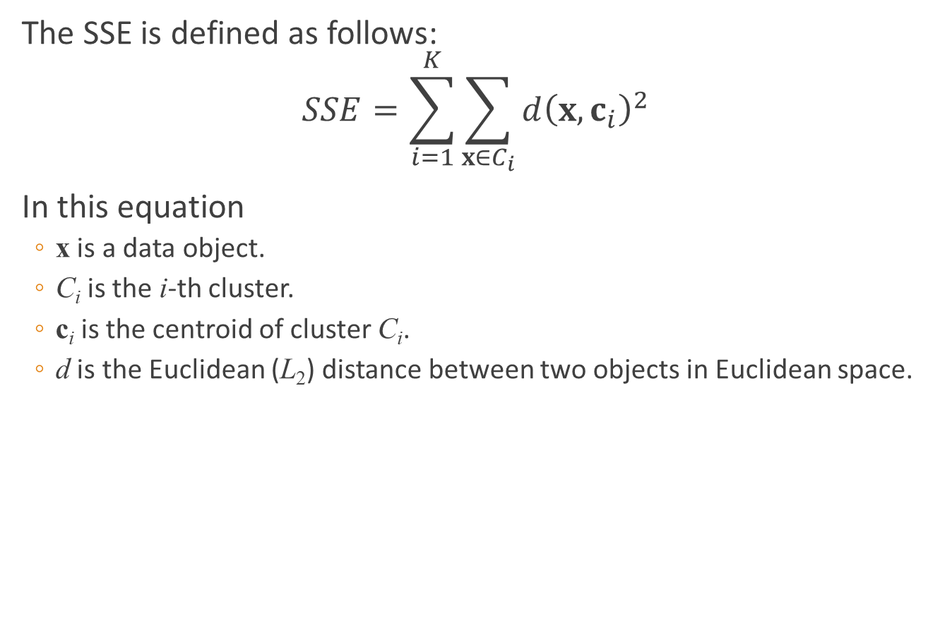
Proximity measure
The SSE is defined as follows:
$$SSE=\sum_{i=1}^{K}{\sum_{x∈C_{i}}{d{\left(x,c_{i}\right)}^{2}}}$$
In this equation
x is a data object.
C_{i} is the i-th cluster.
c_{i} is the centroid of cluster C_{i}.
d is the Euclidean (L₂) distance between two objects in Euclidean space.

Slide 24
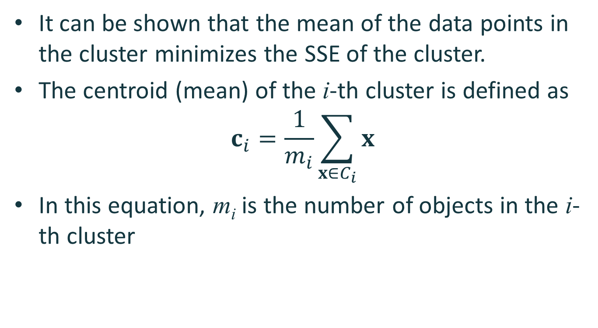
Proximity measure
It can be shown that the mean of the data points in the cluster minimizes the SSE of the cluster.
The centroid (mean) of the i-th cluster is defined as
$$c_{i}=\frac{1}{m_{i}}\sum_{x∈C_{i}}{x}$$
In this equation, m_{i} is the number of objects in the i-th cluster

Slide 25
Proximity measure
Steps 2a and 2b of the K-means algorithm attempt to minimize the SSE.
Step 2a forms clusters by assigning points to their nearest centroid, which minimizes the SSE for the given set of centroids.
Step 2b recomputes the centroids so as to further minimize the SSE.

Slide 26
Choosing initial centroids
Choosing the proper initial centroids is the key step of the basic K-means procedure.
A common approach is to choose the initial centroids randomly.
Randomly selected initial centroids may be poor choices.
This is illustrated in the following figures.

Slide 27
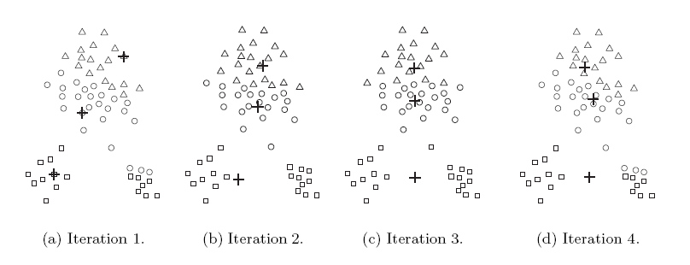
Choosing initial centroids

Slide 28
Choosing initial centroids
One technique that is commonly used to address the problem of choosing initial centroids is to perform multiple runs.
Each run uses a different set of randomly chosen initial centroids.
We then choose the set of clusters with the minimum SSE.

Slide 29
Outliers
When the Euclidean distance is used, outliers can influence the clusters that are found.
When outliers are present, the resulting cluster centroids may not be as representative as they otherwise would be.
The SSE will be higher as well.
Because of this, it is often useful to discover outliers and eliminate them beforehand.

Slide 30
Outliers
To identify the outliers, we can keep track of the contribution of each point to the SSE.
We then eliminate those points with unusually high contributions to the SSE.
We may also want to eliminate small clusters, since they frequently represent groups of outliers.

Slide 31
Post-processing
Two post-processing strategies that decrease the SSE by increasing the number of clusters are
Split a cluster
The cluster with the largest SSE is usually chosen.
Introduce a new cluster centroid
Often the point that is farthest from its associated cluster center is chosen.
We can determine this if we keep track of the contribution of each point to the SSE.

Slide 32
Post-processing
Two post-processing strategies that decrease the number of clusters, while trying to minimize the increase in total SSE, are
Disperse a cluster
This is accomplished by removing the centroid that corresponds to the cluster.
The points in that cluster are then re-assigned to other clusters.
The cluster that is dispersed should be the one that increases the total SSE the least.
Merge two clusters
We can merge the two clusters that result in the smallest increase in total SSE.

Slide 33
Bisecting K-means
Bisecting K-means algorithm is an extension of the basic K-means algorithm.
The main steps of the algorithm are described as follows
To obtain K clusters, split the set of all points into two clusters.
Select one of these clusters to split.
Continue the process until K clusters have been produced.

Slide 34
Bisecting K-means
There are a number of different ways to choose which cluster to split.
We can choose the largest cluster at each step.
We can also choose the one with the largest SSE.
We can also use a criterion based on both size and SSE.
Different choices result in different clusters.
We often refine the resulting clusters by using their centroids as the initial centroids for the basic K-means algorithm.
The bisecting K-means algorithm is illustrated in the following figure.

Slide 35
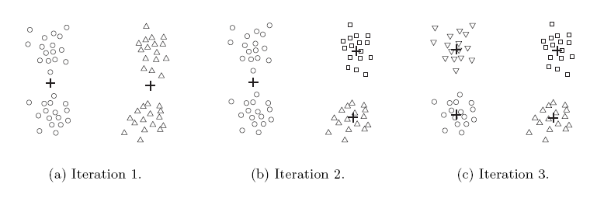
Bisecting K-means

Slide 36
Limitations of K-means
K-means and its variations have a number of limitations with respect to finding different types of clusters.
In particular, K-means has difficulty detecting clusters with non-spherical shapes or widely different sizes or densities.
This is because K-means is designed to look for globular clusters of similar sizes and densities, or clusters that are well separated.
This is illustrated in the following examples.

Slide 37
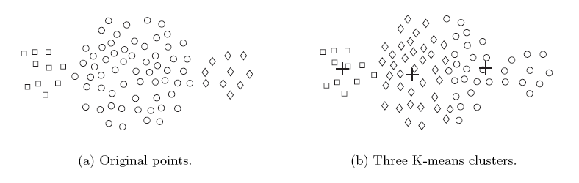
Limitations of K-means
In this example, K-means cannot find the three natural clusters because one of the clusters is much larger than the other two.
As a result, the largest cluster is divided into sub-clusters.
At the same time, one of the smaller clusters is combined with a portion of the largest cluster.

Slide 38
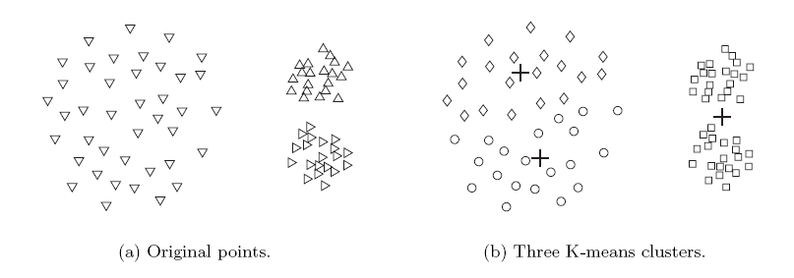
Limitations of K-means
In this example, K-means fails to find the three natural clusters.
This is because the two smaller clusters are much denser than the largest cluster.

Slide 39
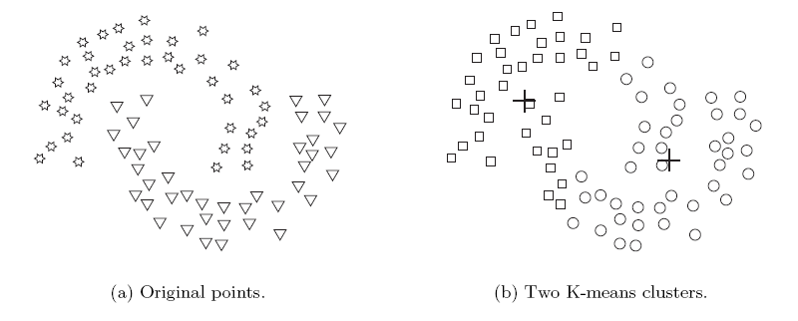
Limitations of K-means
In this example, K-means finds two clusters that mix portions of the two natural clusters.
This is because the shape of the natural clusters is not globular.

Slide 40

DBSCAN
Main idea – Locate regions of high density that are separated from one another by regions of low density
So, how do we measure density of a region ?
Density at a point P: Number of points within a circle of Radius Eps ($ε$) from point P.
Dense Region: For each point in the cluster, the circle with radius $ε$ contains at least minimum number of points (MinPts).
Notes:
Ref: https://towardsdatascience.com/dbscan-algorithm-complete-guide-and-application-with-python-scikit-learn-d690cbae4c5d

Slide 41
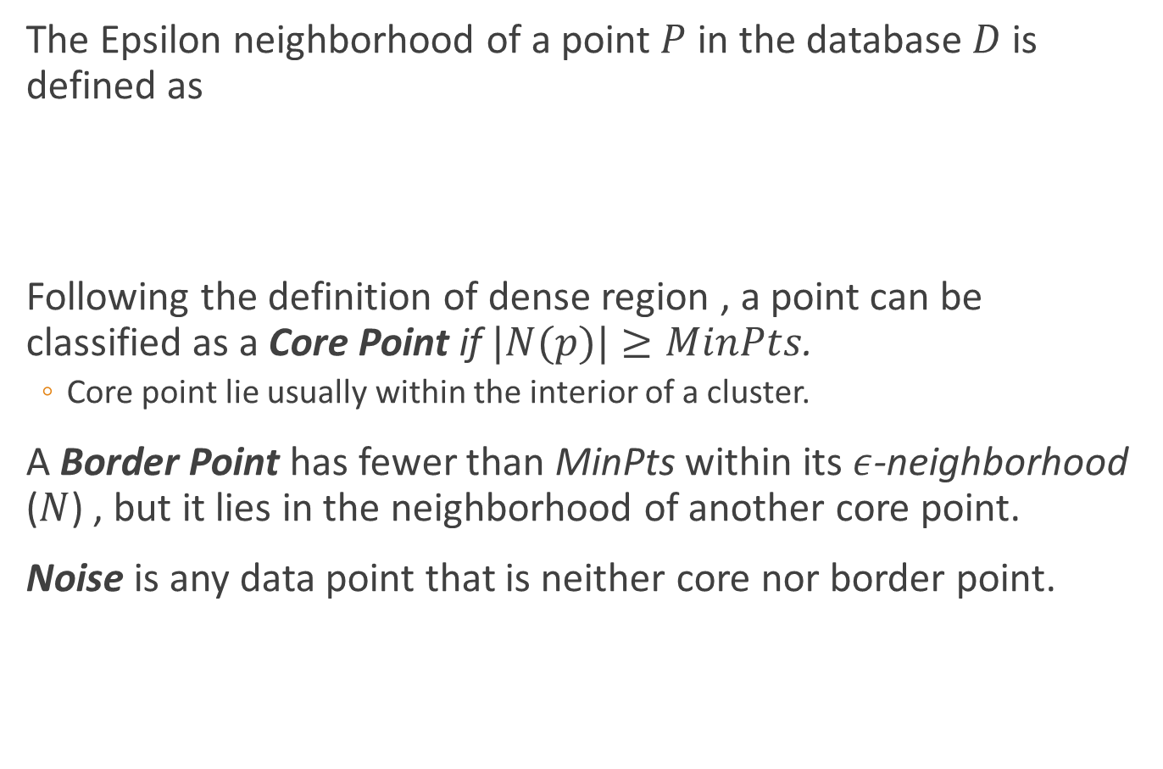

DBSCAN
The Epsilon neighborhood of a point $P$ in the database $D$ is defined as
Following the definition of dense region , a point can be classified as a Core Point if $|N(p)|≥MinPts$.
Core point lie usually within the interior of a cluster.
A Border Point has fewer than MinPts within its $ε$-neighborhood ($N$) , but it lies in the neighborhood of another core point.
Noise is any data point that is neither core nor border point.
$$N (p) = \{q ∈ D | dist(p, q) ≤ ε\}$$
Notes:
https://towardsdatascience.com/dbscan-algorithm-complete-guide-and-application-with-python-scikit-learn-d690cbae4c5d

Slide 42
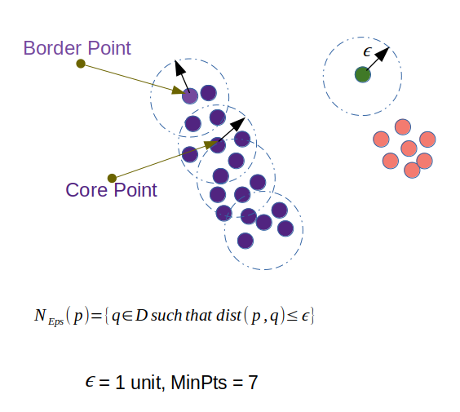
DBSCAN

Slide 43
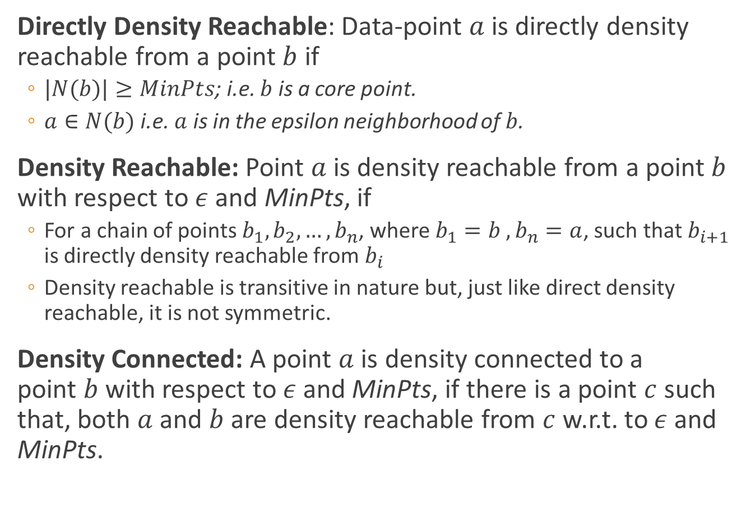
DBSCAN
Directly Density Reachable: Data-point $a$ is directly density reachable from a point $b$ if
$|N(b)|≥MinPts$; i.e. $b$ is a core point.
$a∈N(b)$ i.e. $a$ is in the epsilon neighborhood of $b$.
Density Reachable: Point $a$ is density reachable from a point $b$ with respect to $ε$ and MinPts, if
For a chain of points $b_{1},b_{2},…,b_{n}$, where $b_{1}=b ,b_{n}=a$, such that $b_{i+1}$ is directly density reachable from $b_{i}$
Density reachable is transitive in nature but, just like direct density reachable, it is not symmetric.
Density Connected: A point $a$ is density connected to a point $b$ with respect to $ε$ and MinPts, if there is a point $c$ such that, both $a$ and $b$ are density reachable from $c$ w.r.t. to $ε$ and MinPts.
Notes:
One problem of this approach could be — ϵ-neighborhood of the border points contain significantly less number of points than the core points. Since MinPts is a parameter in the algorithm, setting it to a low value to include the border points in the cluster can cause problem to eliminate the noise. Here comes the concept of density-reachable and density-connected points.

Slide 44
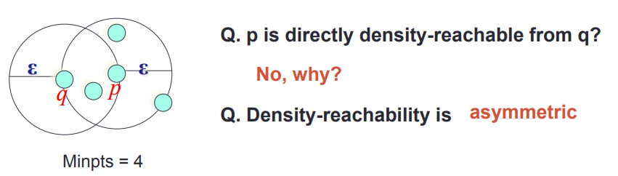

DBSCAN
Directly Density Reachable: Data-point $a$ is directly density reachable from a point $b$ if
$|N(b)|≥MinPts$; i.e. $b$ is a core point.
$a∈N(b)$ i.e. $a$ is in the epsilon neighborhood of $b$.
Notes:
One problem of this approach could be — ϵ-neighborhood of the border points contain significantly less number of points than the core points. Since MinPts is a parameter in the algorithm, setting it to a low value to include the border points in the cluster can cause problem to eliminate the noise. Here comes the concept of density-reachable and density-connected points.

Slide 45
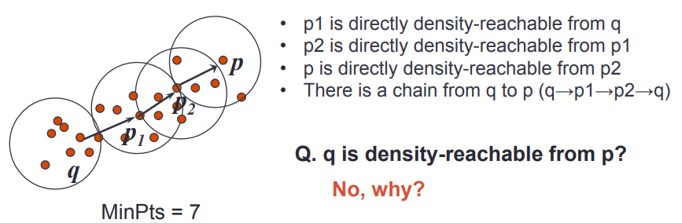

DBSCAN
Density Reachable: Point $a$ is density reachable from a point $b$ with respect to $ε$ and MinPts, if
For a chain of points $b_{1},b_{2},…,b_{n}$, where $b_{1}=b ,b_{n}=a$, such that $b_{i+1}$ is directly density reachable from $b_{i}$
Density reachable is transitive in nature but, just like direct density reachable, it is not symmetric.
Notes:
One problem of this approach could be — ϵ-neighborhood of the border points contain significantly less number of points than the core points. Since MinPts is a parameter in the algorithm, setting it to a low value to include the border points in the cluster can cause problem to eliminate the noise. Here comes the concept of density-reachable and density-connected points.

Slide 46
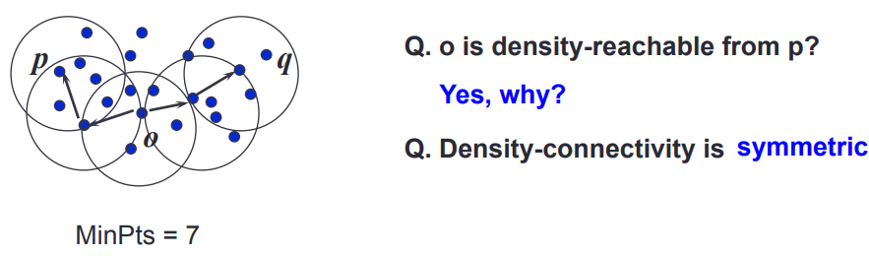

DBSCAN
Density Connected: A point $a$ is density connected to a point $b$ with respect to $ε$ and MinPts, if there is a point $c$ such that, both $a$ and $b$ are density reachable from $c$ w.r.t. to $ε$ and MinPts.
Notes:
One problem of this approach could be — ϵ-neighborhood of the border points contain significantly less number of points than the core points. Since MinPts is a parameter in the algorithm, setting it to a low value to include the border points in the cluster can cause problem to eliminate the noise. Here comes the concept of density-reachable and density-connected points.

Slide 47
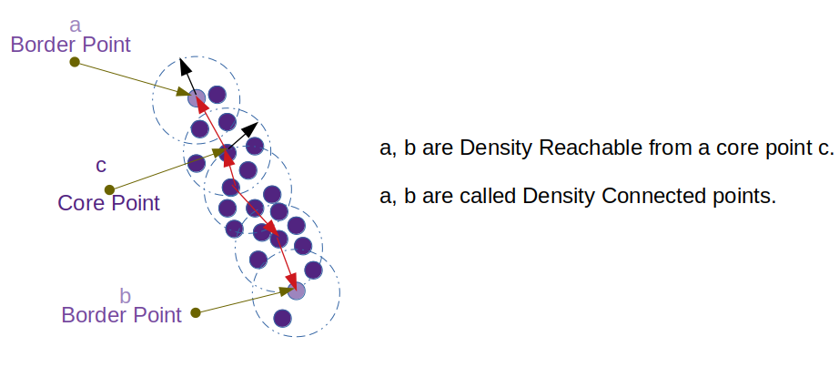
DBSCAN

Slide 48
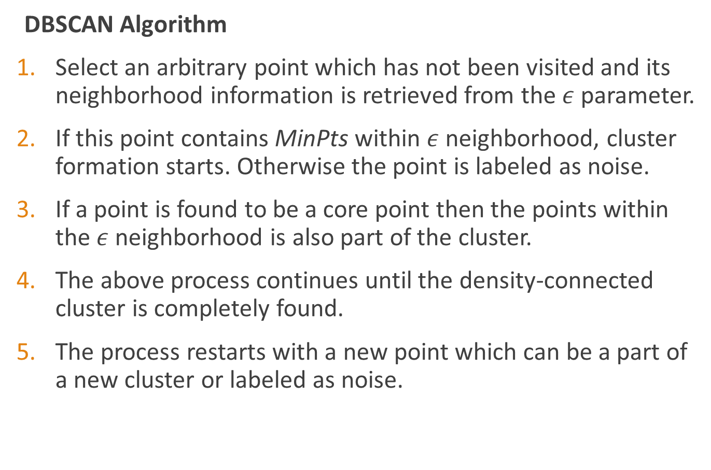
DBSCAN
DBSCAN Algorithm
Select an arbitrary point which has not been visited and its neighborhood information is retrieved from the $ε$ parameter.
If this point contains MinPts within $ε$ neighborhood, cluster formation starts. Otherwise the point is labeled as noise.
If a point is found to be a core point then the points within the $ε$ neighborhood is also part of the cluster.
The above process continues until the density-connected cluster is completely found.
The process restarts with a new point which can be a part of a new cluster or labeled as noise.

Slide 49
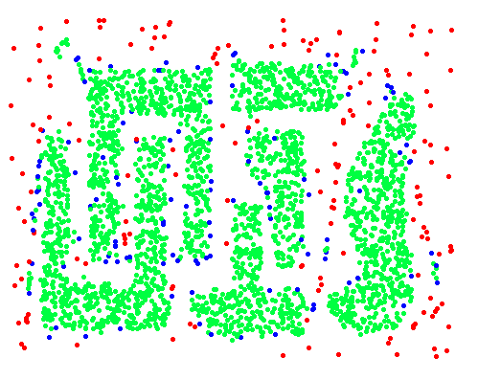
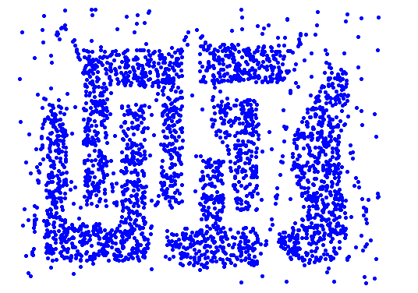
DBSCAN
Example
Original Points
Point types: core,
border and outliers

Slide 50
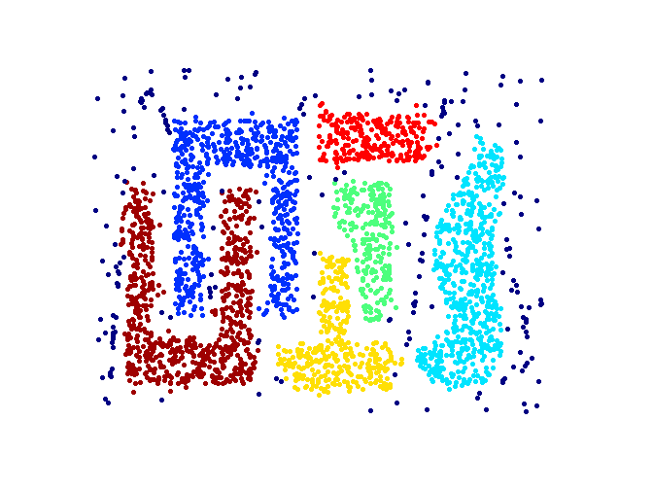
DBSCAN
Resistant to Noise
Can handle clusters of different shapes and sizes

Slide 51
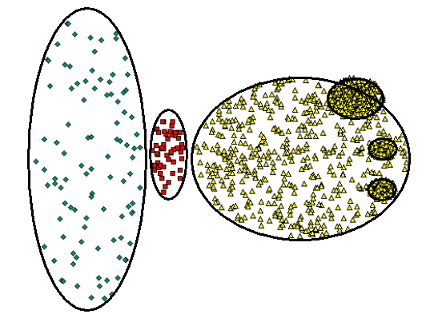
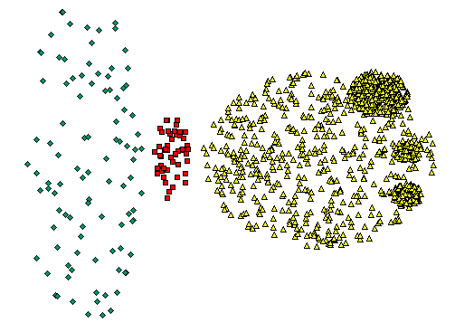
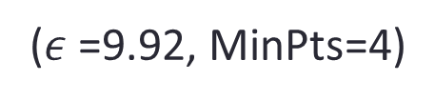
DBSCAN
Drawbacks
If the database has data points that form clusters of varying density, then DBSCAN fails to cluster the data points well
If the data and features are not so well understood by a domain expert then, setting up ϵ and MinPts could be tricky and, may need comparisons for several iterations with different values of ϵ and MinPts.
($ε$ =9.92, MinPts=4)

Slide 52
Hierarchical clustering
A hierarchical clustering is a set of nested clusters that are organized as a tree.
There are two basic approaches for generating a hierarchical clustering
Agglomerative
Divisive

Slide 53
Hierarchical clustering
In agglomerative hierarchical clustering, we start with the points as individual clusters.
At each step, we merge the closest pair of clusters.
This requires defining a notion of cluster proximity.

Slide 54
Hierarchical clustering
In divisive hierarchical clustering, we start with one, all-inclusive cluster.
At each step, we split a cluster.
This process continues until only singleton clusters of individual points remain.
In this case, we need to decide
Which cluster to split at each step and
How to do the splitting.

Slide 55
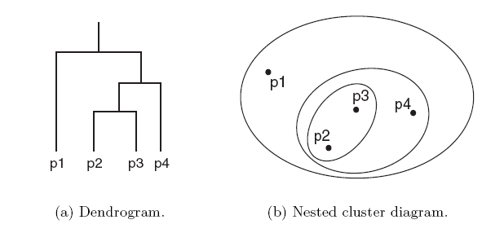
Hierarchical clustering
A hierarchical clustering is often displayed graphically using a tree-like diagram called the dendrogram.
The dendrogram displays both
the cluster-subcluster relationships and
the order in which the clusters are merged (agglomerative) or split (divisive).
For sets of 2-D points, a hierarchical clustering can also be graphically represented using a nested cluster diagram.

Slide 56
Hierarchical clustering
The basic agglomerative hierarchical clustering algorithm is summarized as follows
Compute the proximity matrix.
Repeat
Merge the closest two clusters
Update the proximity matrix to reflect the proximity between the new cluster and the original clusters.
Until only one cluster remains

Slide 57
Hierarchical clustering
Different definitions of cluster proximity leads to different versions of hierarchical clustering.
These versions include
Single link or MIN
Complete link or MAX
Group average
Ward’s method

Slide 58
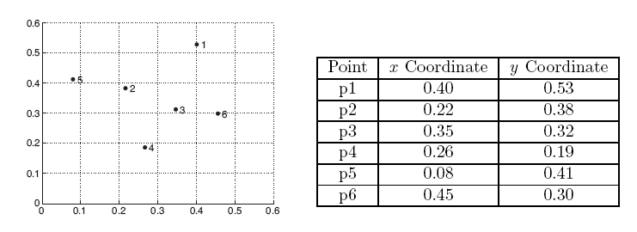
Hierarchical clustering
We consider the following set of data points.
The Euclidean distance matrix for these data points is shown in the following slide.

Slide 59
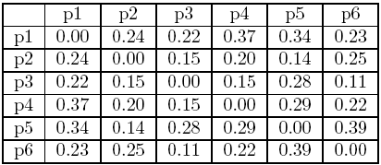
Hierarchical clustering

Slide 60
Single link
We now consider the single link or MIN version of hierarchical clustering.
In this case, the proximity of two clusters is defined as the minimum of the distance between any two points in the two different clusters.
This technique is good at handling non-elliptical shapes.
However, it is sensitive to noise and outliers.

Slide 61
Single link
The following figure shows the result of applying single link technique to our example data.
The left figure shows the nested clusters as a sequence of nested ellipses.
The numbers associated with the ellipses indicate the order of the clustering.
The right figure shows the same information in the form of a dendrogram.
The height at which two clusters are merged in the dendrogram reflects the distance of the two clusters.

Slide 62
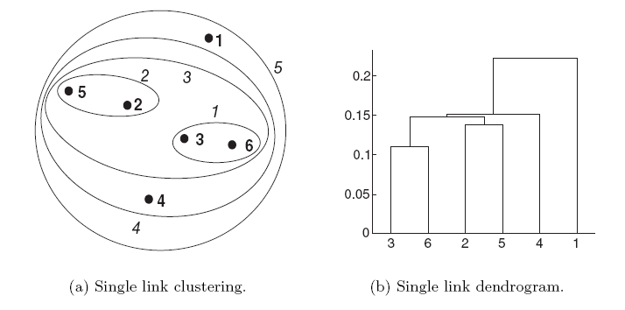
Single link

Slide 63
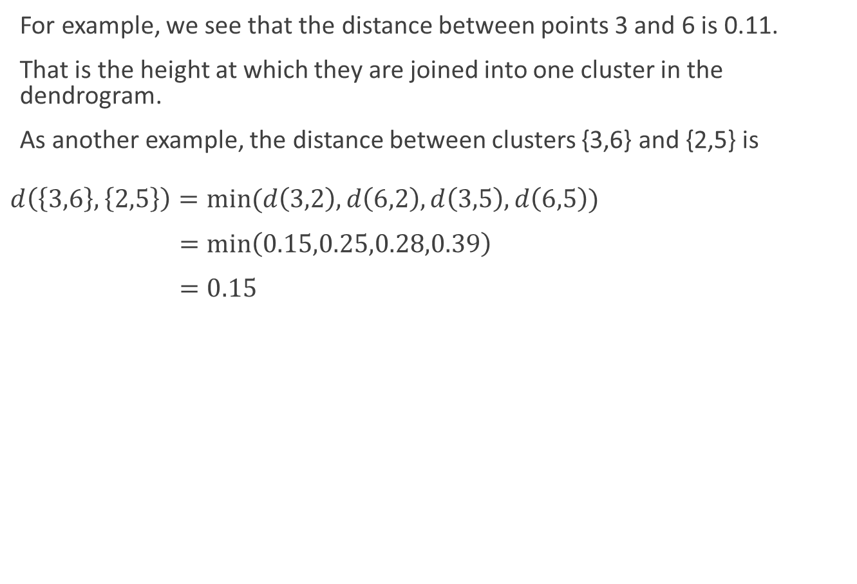
Single link
For example, we see that the distance between points 3 and 6 is 0.11.
That is the height at which they are joined into one cluster in the dendrogram.
As another example, the distance between clusters {3,6} and {2,5} is
$$d\left(\left\{3,6\right\},\left\{2,5\right\}\right)=min⁡(d\left(3,2\right),d\left(6,2\right),d\left(3,5\right),d\left(6,5\right))$$
$=\min\left(0.15,0.25,0.28,0.39\right)$
$=0.15$

Slide 64
Complete link
We now consider the complete link or MAX version of hierarchical clustering.
In this case, the proximity of two clusters is defined as the maximum of the distance between any two points in the two different clusters.
Complete link is less susceptible to noise and outliers.
However, it tends to produce clusters with globular shapes.

Slide 65
Complete link
The following figure shows the results of applying the complete link approach to our sample data points.
As with single link, points 3 and 6 are merged first.
However, {3,6} is merged with {4}, instead of {2,5} or {1}.

Slide 66
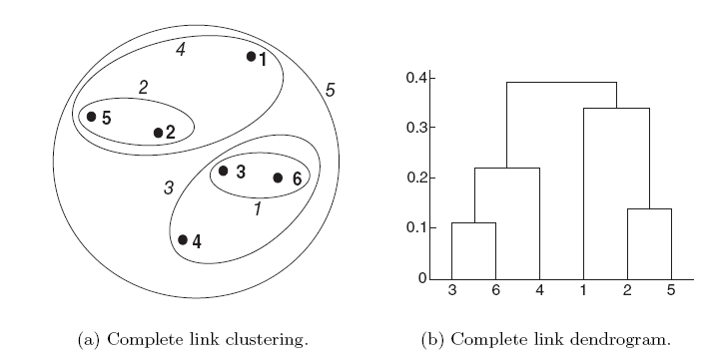
Complete link

Slide 67
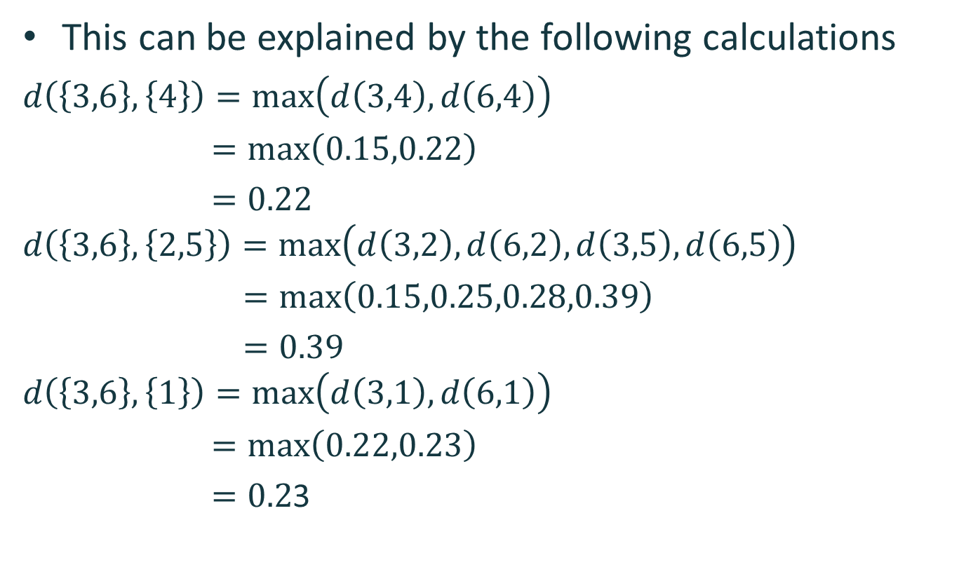
Complete link
This can be explained by the following calculations
$$d\left(\left\{3,6\right\},\left\{4\right\}\right)=\max\left(d\left(3,4\right),d\left(6,4\right)\right)$$
$=\max\left(0.15,0.22\right)$
$=0.22$
$$d\left(\left\{3,6\right\},\left\{2,5\right\}\right)=\max\left(d\left(3,2\right),d\left(6,2\right),d\left(3,5\right),d\left(6,5\right)\right)$$
$=\max\left(0.15,0.25,0.28,0.39\right)$
$=0.39$
$$d\left(\left\{3,6\right\},\left\{1\right\}\right)=\max\left(d\left(3,1\right),d\left(6,1\right)\right)$$
$=\max\left(0.22,0.23\right)$
$=0.2$3

Slide 68
Group average
We now consider the group average version of hierarchical clustering.
In this case, the proximity of two clusters is defined as the average pairwise proximity among all pairs of points in the different clusters.
This is an intermediate approach between the single and complete link approaches.

Slide 69
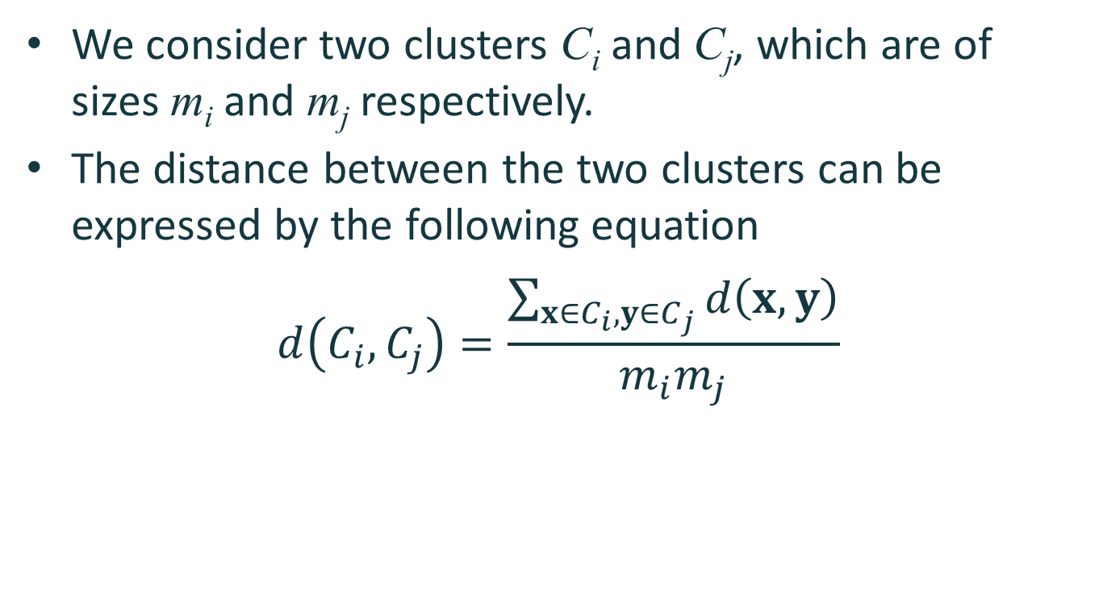
Group average
We consider two clusters C_{i} and C_{j}, which are of sizes m_{i} and m_{j} respectively.
The distance between the two clusters can be expressed by the following equation
$$d\left(C_{i},C_{j}\right)=\frac{\sum_{x∈C_{i},y∈C_{j}}{d\left(x,y\right)}}{m_{i}m_{j}}$$

Slide 70
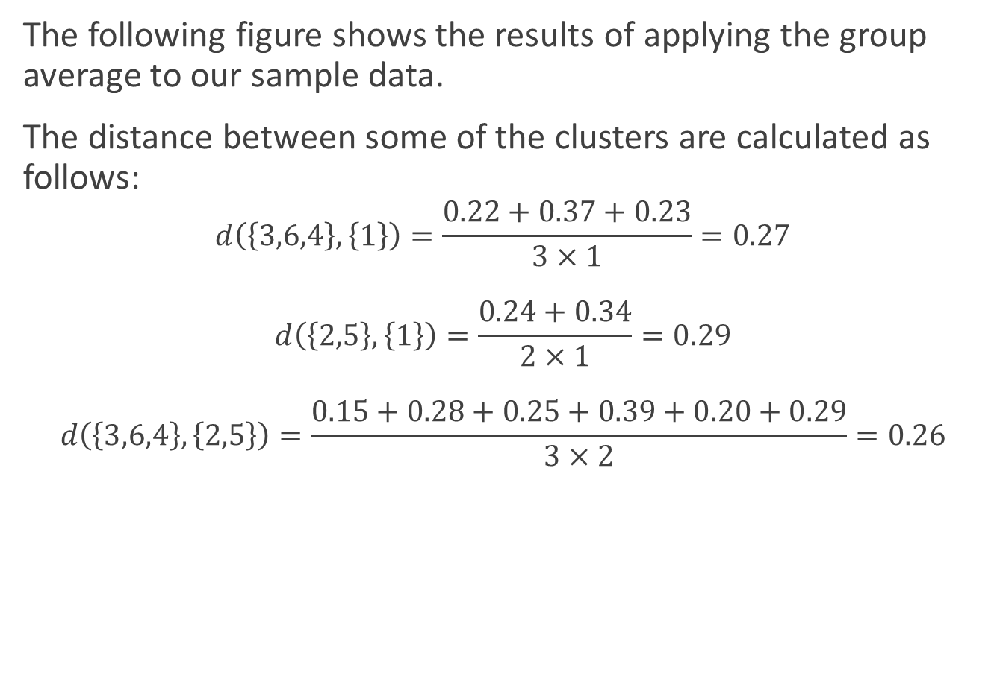
Group average
The following figure shows the results of applying the group average to our sample data.
The distance between some of the clusters are calculated as follows:
$$d\left(\left\{3,6,4\right\},\left\{1\right\}\right)=\frac{0.22+0.37+0.23}{3×1}=0.27$$
$$d\left(\left\{2,5\right\},\left\{1\right\}\right)=\frac{0.24+0.34}{2×1}=0.29$$
$$d\left(\left\{3,6,4\right\},\left\{2,5\right\}\right)=\frac{0.15+0.28+0.25+0.39+0.20+0.29}{3×2}=0.26$$

Slide 71
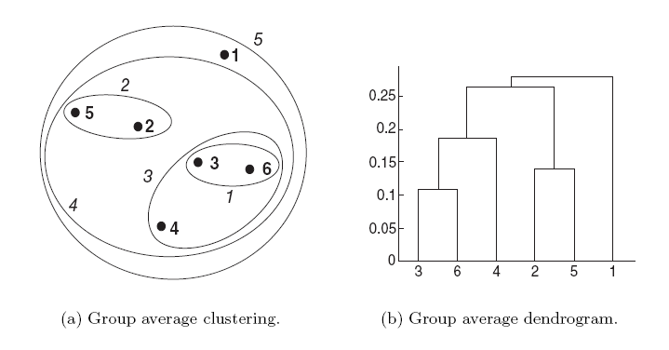
Group average

Slide 72
Group average
We observe that d({3,6,4},{2,5}) is smaller than d({3,6,4},{1}) and d({2,5},{1}).
As a result, {3,6,4} and {2,5} are merged at the fourth stage.

Slide 73
Ward’s method
We now consider Ward’s method for hierarchical clustering.
In this case, the proximity between two clusters is defined as the increase in the sum of the squared error that results when they are merged.
Thus, this method uses the same objective function as k-means clustering.

Slide 74
Ward’s method
The following figure shows the results of applying Ward’s method to our sample data.
The clustering that is produced is different from those produced by single link, complete link and group average.

Slide 75
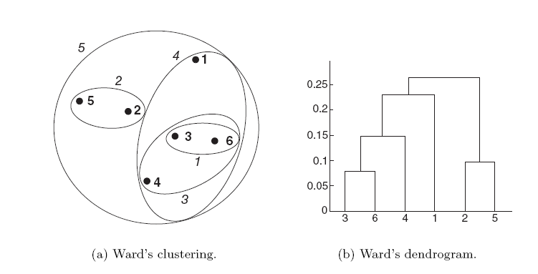
Ward’s method

Slide 76
Key issues
Hierarchical clustering is effective when the underlying application requires the creation of a multi-level structure.
However, they are expensive in terms of their computational and storage requirements.
In addition, once a decision is made to merge two clusters, it cannot be undone at a later time.

Slide 77
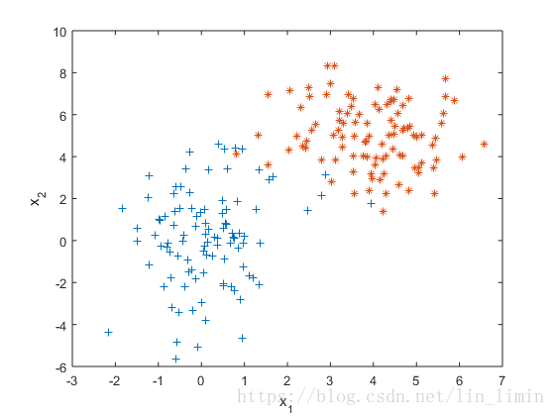
Cluster using Gaussian mixture model
Notes:
https://blog.csdn.net/lin_limin/article/details/81048411

Slide 78
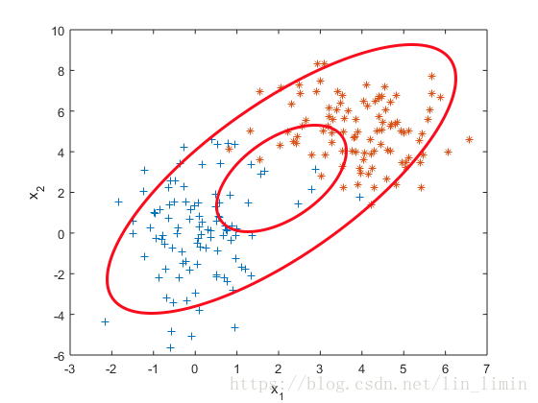
Cluster using Gaussian mixture model

Slide 79
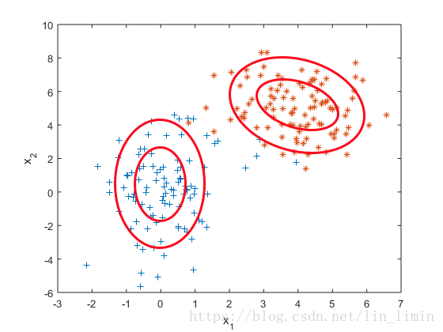
Cluster using Gaussian mixture model

Slide 80
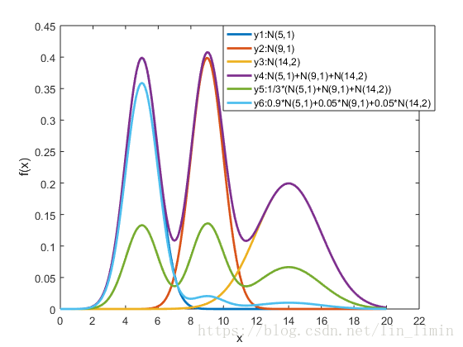
Cluster using Gaussian mixture model

Slide 81
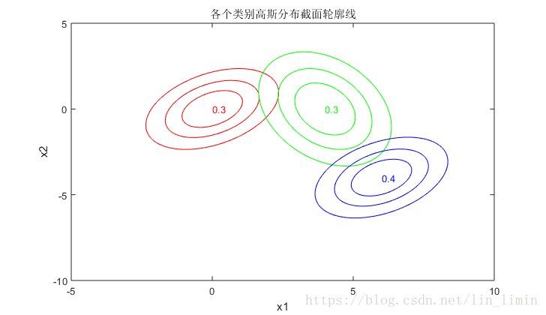
Cluster using Gaussian mixture model

Slide 82
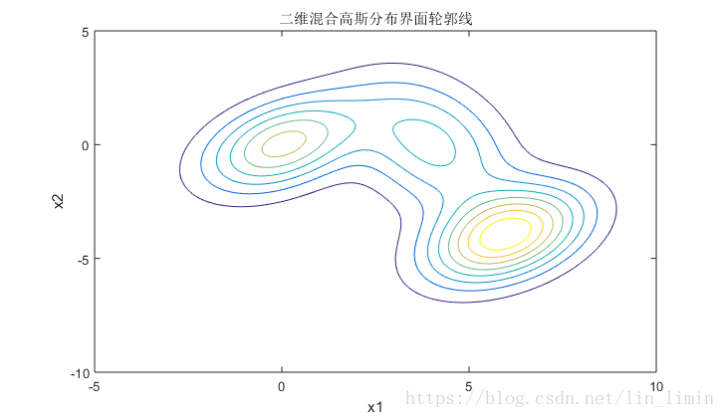
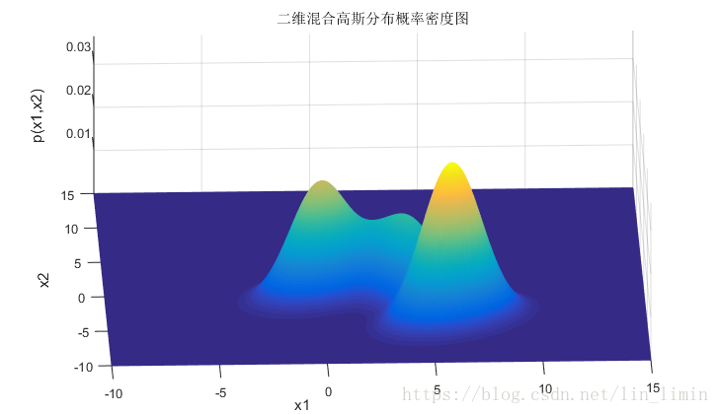
Cluster using Gaussian mixture model

Slide 83
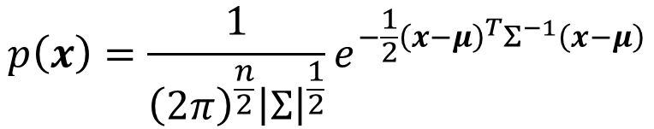

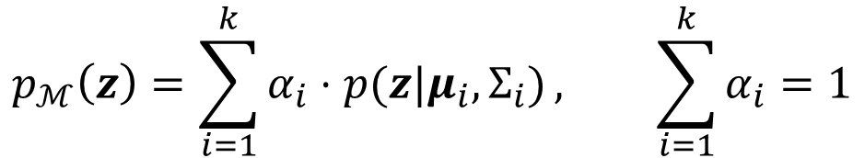
Cluster using Gaussian mixture model
The PDF $p(x|μ,Σ)$ of multi-variate Gaussian distribution
Observed: $z_{1},z_{2},…,z_{n}$
$X \sim$ Multinomial Distribution
$Z \sim N(μ_{i},Σ_{i})$
Gaussian mixture model
$$p\left(x\right)=\frac{1}{{\left(2π\right)}^{\frac{n}{2}}{\left|Σ\right|}^{\frac{1}{2}}}e^{−\frac{1}{2}{\left(x−μ\right)}^{T}Σ^{−1}\left(x−μ\right)}$$
Mixture coefficient
$$p_{ℳ}\left(z\right)=\sum_{i=1}^{k}{α_{i}⋅p(z|μ_{i},Σ_{i})}, \sum_{i=1}^{k}{α_{i}}=1$$

Slide 84
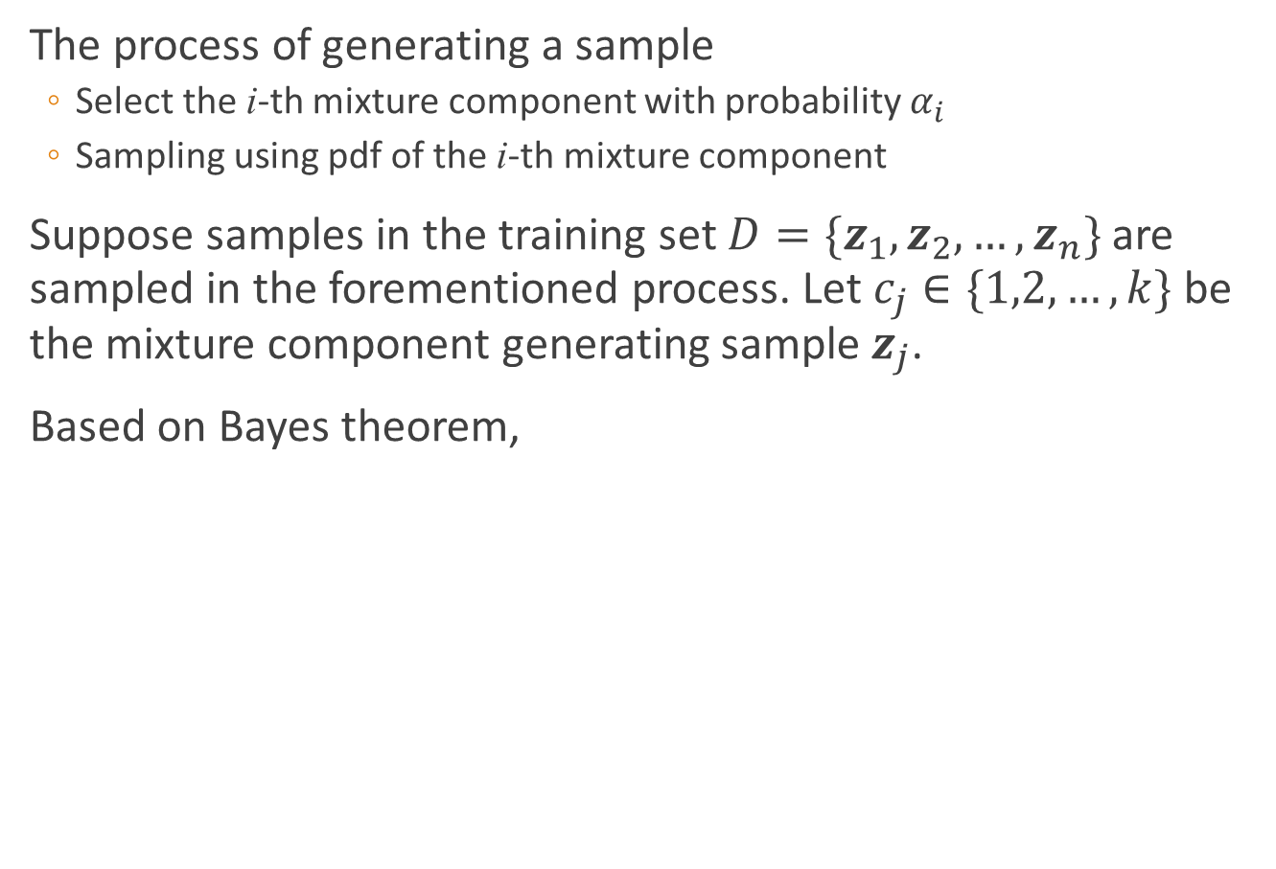



Cluster using Gaussian mixture model
The process of generating a sample
Select the i-th mixture component with probability $α_{i}$
Sampling using pdf of the i-th mixture component
Suppose samples in the training set $D=\{z_{1},z_{2},…,z_{n}\}$ are sampled in the forementioned process. Let $c_{j}∈\{1,2,…,k\}$ be the mixture component generating sample $z_{j}$.
Based on Bayes theorem,
$$γ_{ji}$$
$$p_{ℳ}\left(c_{j}=i | z_{j}\right)=\frac{P\left(c_{j}=i\right)⋅p_{ℳ}(z_{j}|c_{j}=i)}{p_{ℳ}(z_{j})}$$
$$=\frac{α_{i}⋅p(z_{j};μ_{i},Σ_{i})}{\sum_{l=1}^{k}{α_{l}⋅p(z_{j};μ_{l},Σ_{l})}}$$
posterior probability of $z_{j}$ generated by i-th component
Notes:
https://blog.csdn.net/lotusng/article/details/79990724
首先，当i=1，比如这里是指坏瓜类，那么这时坏瓜的高斯曲线已知已确定了（即μ1、Σ1已确定）。根据这个确定高斯曲线可以得到样本瓜x在坏瓜类中存在的概率p(x∣μ1)
然后， p(x∣μi)与 αi相乘的结果就是从坏瓜类中抽中样本瓜x的概率。
最后，分别计算i=1（从坏瓜类中抽）、i=2（从一般瓜类中抽）和i=3（从好瓜类中抽）的情况下抽到样本瓜x的概率，将这三种情况下的概率相加，得到的Pm(x)即是在自然界中抽一个瓜正好抽中样本瓜x的概率

Slide 85




Cluster using Gaussian mixture model
Training set $D$ can be divided into $k$ clusters $\{C_{1},C_{2},…,C_{k}\}$. The cluster $λ_{j}$ of $z_{j}$ can be determined by
If $α_{i},μ_{i},Σ_{i}$ are known, $γ_{ji}$ and $λ_{j}$ can be easily computed
However, $α_{i},μ_{i},Σ_{i}$ are unknown
Complete data: $(z_{j},γ_{j1},γ_{j2},…,γ_{jk})$
$$λ_{j}=\arg{\max_{i∈\{1,2, …,k\}}{ γ_{ji}}}, λ_{j}∈\left\{C_{1},C_{2},…,C_{k}\right\}$$
How to determine parameters $\{(α_{i},μ_{i},Σ_{i})|1≤i≤k\}$ in GMM?

Slide 86


Recall – EM algorithm
E-step: For $i=1,…,m$fill in missing data $(γ_{j1},γ_{j2},…,γ_{jk})$ according to what is most likely given the current model
M-step: run ML for completed data, which gives new model
EM Algorithm: Iterate
1. E-step: Compute $q\left(x\right)=p(x|z;θ)$
2. M-step: Compute $θ=\arg{\max_{θ}{\int_{x}{q\left(x\right)\log{p\left(x,z;θ\right)}dx}}}$

Slide 87



Cluster using Gaussian mixture model
E-step:
M-step:
$$γ_{ji}=p_{ℳ}\left(c_{j}=i | z_{j};α_{i},μ_{i},Σ_{i}\right) =\frac{p_{ℳ}({c_{j}=i,z}_{j};α_{i},μ_{i},Σ_{i})}{p_{ℳ}(z_{j};α_{i},μ_{i},Σ_{i})}$$
$$=\frac{α_{i}⋅p(z_{j};μ_{i},Σ_{i})}{\sum_{l=1}^{k}{α_{l}⋅p(z_{j};μ_{l},Σ_{l})}}$$
$$∝p_{ℳ}\left({c_{j}=i,z}_{j};α_{i},μ_{i},Σ_{i}\right)$$
$$=α_{i}⋅p(z_{j};μ_{i},Σ_{i})$$
$$\max_{α,μ,Σ}{\sum_{j=1}^{n}{\sum_{i=1}^{k}{γ_{ji}\log{(α_{i}⋅p(z_{j};μ_{i},Σ_{i})\text{)}}}}}≜\max_{α,μ,Σ}{L\left(α,μ,Σ\right)}$$

Slide 88





Cluster using Gaussian mixture model
For $α_{i}$, there are two constraints: 1) $α_{i}≥0$; 2) $\sum_{i=1}^{k}{α_{i}}=1$
Construct a Lagrange function $F\left(α,λ\right)$
$$F\left(α,λ\right)=L(α)+λ\left(\sum_{i=1}^{k}{α_{i}}−1\right)$$
$$\frac{∂F}{∂α_{i}}=0⇒\frac{\sum_{j=1}^{n}{γ_{ji}}}{α_{i}}+λ=0$$
$$\left.\begin{matrix}\begin{matrix} \\ \end{matrix} \\ \begin{matrix} \\ \end{matrix}\end{matrix}\right\}⇒α_{i}=\frac{1}{n}\sum_{j=1}^{n}{γ_{ji}}$$
$$λ=−n$$

Slide 89





Cluster using Gaussian mixture model
If $\{(α_{i},μ_{i},Σ_{i})|1≤i≤k\}$ maximize $LL\left(D\right)$ $⇒$
Similarly,
$$\frac{∂L}{∂μ_{i}}=0⇒\frac{∂(\sum_{j=1}^{n}{γ_{ji}}\log{(a_{i}p(z_{j};μ_{i},Σ_{i}))})}{∂μ_{i}}=0$$
$$⇒\frac{∂(\sum_{j=1}^{n}{γ_{ji}}\log{(p(z_{j};μ_{i},Σ_{i}))})}{∂μ_{i}}=0$$
$$⇒μ_{i}=\frac{\sum_{j=1}^{m}{γ_{ji}z_{j}}}{\sum_{j=1}^{m}{γ_{ji}}}$$
$$\frac{∂L}{∂Σ_{i}}=0⇒Σ_{i}=\frac{\sum_{j=1}^{m}{γ_{ji}\left(x_{j}−μ_{i}\right){\left(x_{j}−μ_{i}\right)}^{T}}}{\sum_{j=1}^{m}{γ_{ji}}}$$

Slide 90

Cluster using Gaussian mixture model
EM algorithm in GMM
E step:
Compute posterior probability $γ_{ji}$ using current parameters
M step:
Update parameters $\{(α_{i},μ_{i},Σ_{i})\}$

Slide 91

Cluster using Gaussian mixture model
Input: Dataset $D=\left\{x_{1},x_{2},…,x_{m}\right\};\# of Gaussian mixture component$
1: Initialize parameters $\{(α_{i},μ_{i},Σ_{i})\}$
2: repeat
3: for $j=1,2,..,m$ do
4: compute $γ_{ji}=p_{ℳ}\left(z_{j}=i | x_{j}\right)\left(1≤i≤k\right)$
5: for $i=1,2,…,k$ do
6: compute $μ_{i}^{′}=\frac{\sum_{j=1}^{m}{γ_{ji}x_{j}}}{\sum_{j=1}^{m}{γ_{ji}}},Σ_{i}^{′}=\frac{\sum_{j=1}^{m}{γ_{ji}\left(x_{j}−μ_{i}\right){\left(x_{j}−μ_{i}\right)}^{T}}}{\sum_{j=1}^{m}{γ_{ji}}},$ $α_{i}^{′}=\frac{1}{m}\sum_{j=1}^{m}{γ_{ji}}$
7: update $\left\{\left(α_{i},μ_{i},Σ_{i}\right)\right\}$ with $\{(α_{i}^{′},μ_{i}^{′},Σ_{i}^{′})\}$
8: until stop criteria is satisfied
9: $C_{i}=∅(1≤i≤k)$
10: for $j=1,2,..,m$ do
11: compute $λ_{j}$
12: $C_{λ_{j}}=C_{λ_{j}}∪\left\{x_{j}\right\}$
Output: $\{C_{1},C_{2},…,C_{k}\}$

Slide 92

Cluster using Gaussian mixture model

